Slide 1
TABLEAU
Formatting and visualization

Slide 2
1.Find the profit and sales for each subcategory of every type of product.
2. Which subcategory has highest profit in the year 2019.
3. In case 1, change the color of the view from the Marks card.
4. In the view, in the Sub-Category filter card, clear all of the check boxes except Bookcases, Machines, and Tables to have closer look on each value.
5. Find out the key insights about in which year bookcases and machines were profitable and unprofitable.
6. Show the sales region wise for every subcategory and category and every year.
7. Duplicate your worksheet and check sales region vise for Machine type subcategory.
8. In which region you are reporting a higher negative profit overall than in your other regions.
9. Show your view for Sales in the South for all subcategory.
10. Which subcategory has highest overall negative profit in the south region. 11. Take some decisions to improve profit in the south.

Slide 3
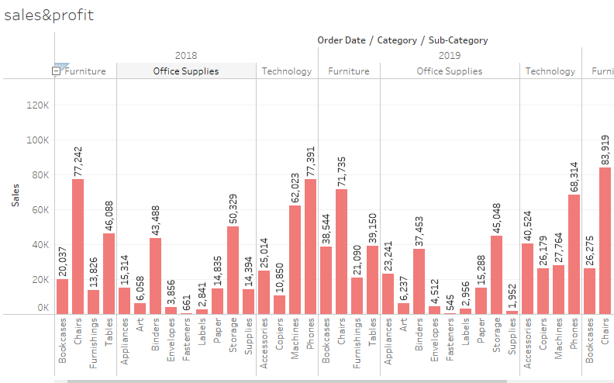
1)find the sales and profit for each subcategory for every type of product.

Slide 4
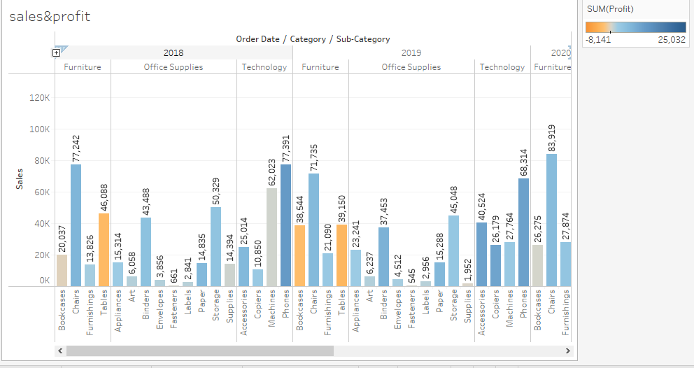
2)Which subcategory is highest sales in 2019

Slide 5
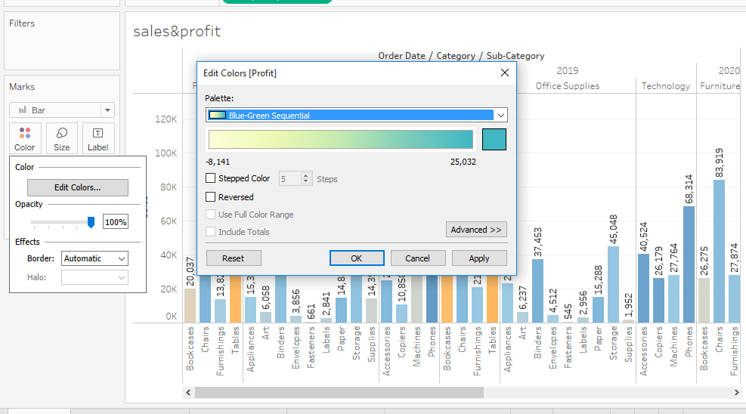
3)change the color of view from the marks card.

Slide 6
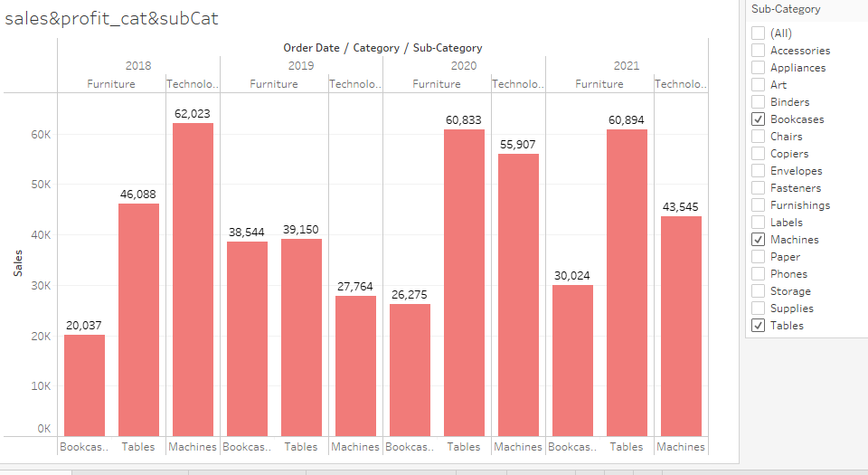
4)clear all of the check boxes and except the bookcase, machine and tables have closer look on each value.

Slide 7
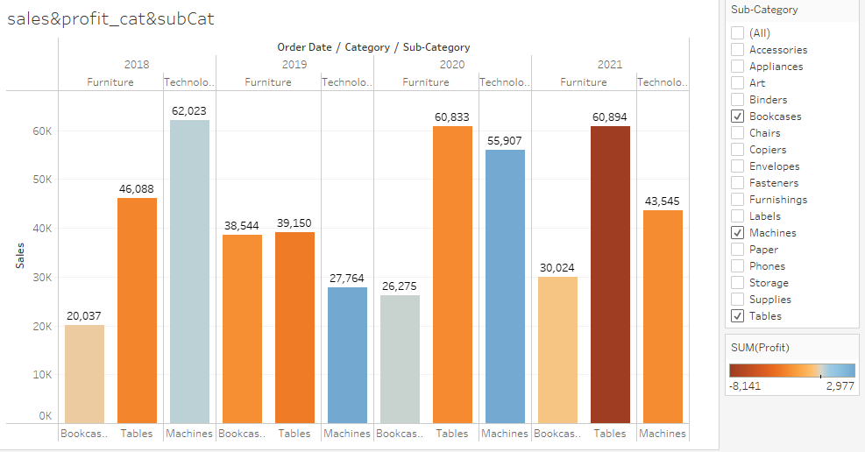
5)Bookcase, machine and table were checking the profitable and unprofitable.

Slide 8
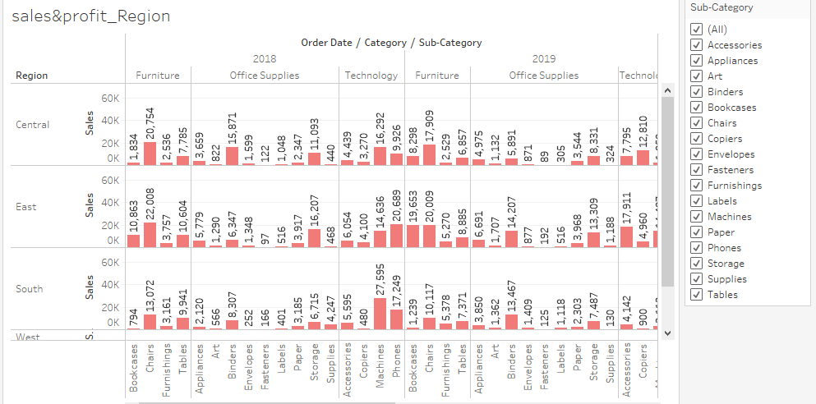
6)show the region wise for every subcat&cat and every yr

Slide 9
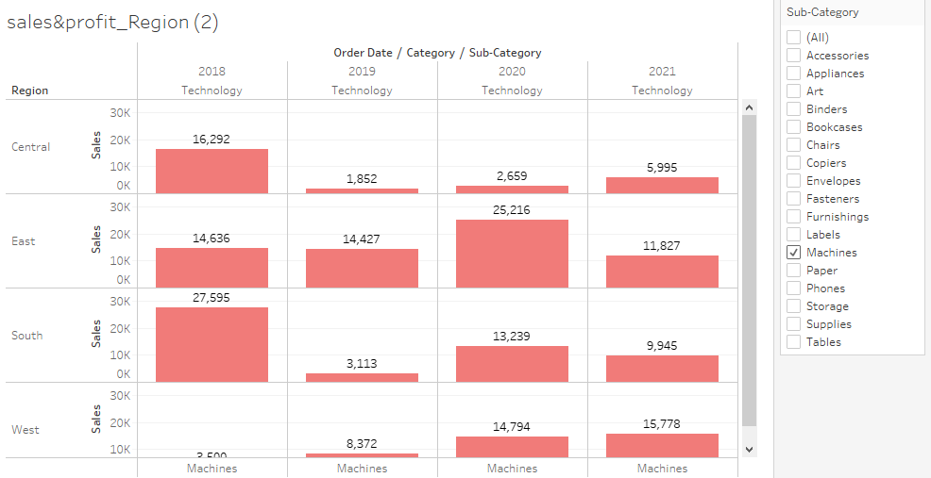
7)duplicate your worksheet and check region vise for machine type subcategory.

Slide 10
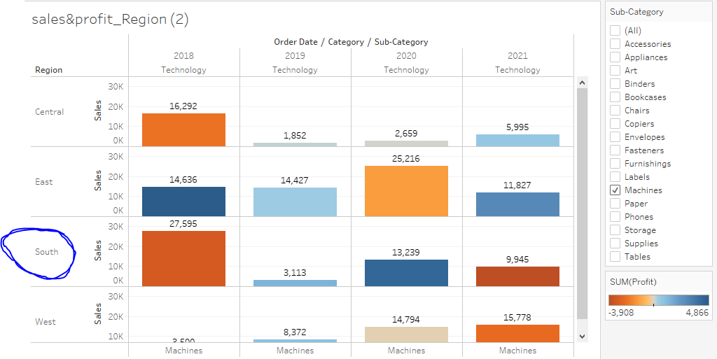
8)in which region you are reporting a higher negative profit overall than in your other region.

Slide 11
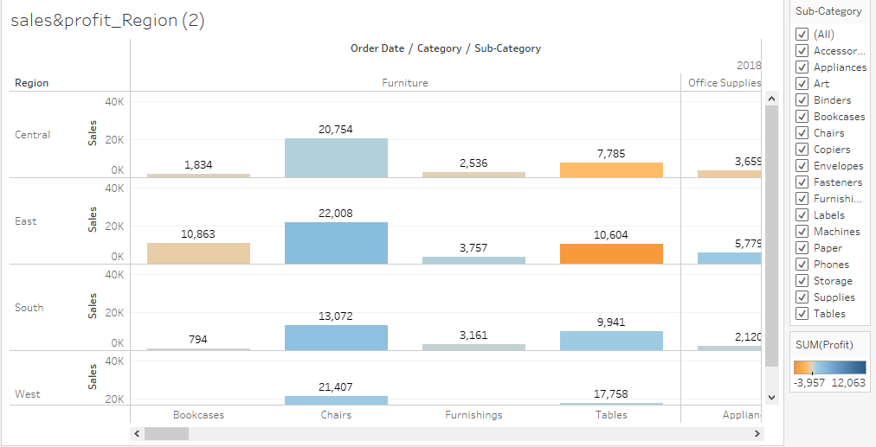
9)show your view for sales in the south for all subcat.

Slide 12
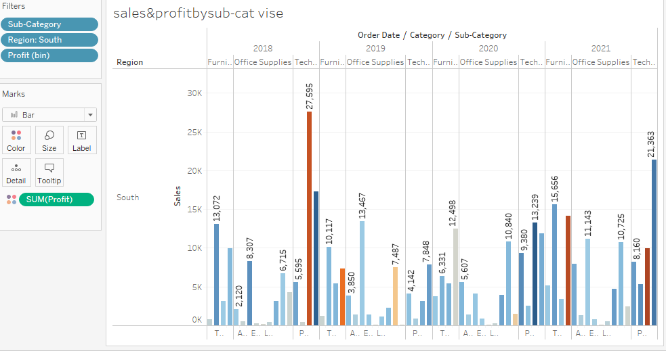
10)which subcat ha highest overall neg profit in south.r

Slide 13
11)take some decision to improve the profit in south.
1)category wise, furniture category has recorded highest (-584) negative growth (over profit) so focusing on that may improve overall profit in the region.
2)if we observe subcategory wise, machine under technology category has recorded highest negative profit(-3908) and phones subcategory wise has recorded positive profit(+3232) in 2001 so focusing on sales under these two subcategories may improve the overall profit in the region.

Slide 14
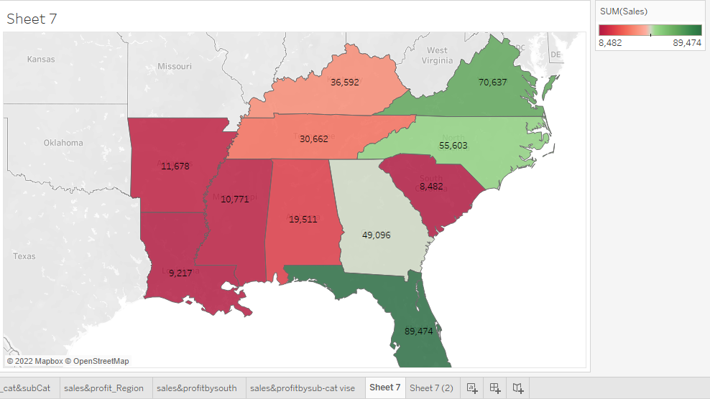
12)Rename the worksheet

Slide 15
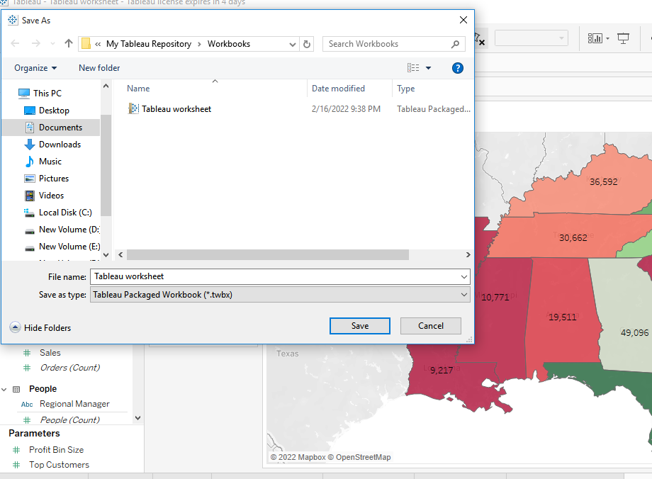
12)save your workbook

